Slide 1
THE ART OF

Slide 2
THE ART OF MAKING
NASIR JUMANI
ZAID PIRWANI

Slide 3
THE ART OF MAKING
NASIR JUMANI
ZAID PIRWANI
We are MAKERs

Slide 4
HAVE YOU MADE SOMETHING ?

Slide 5
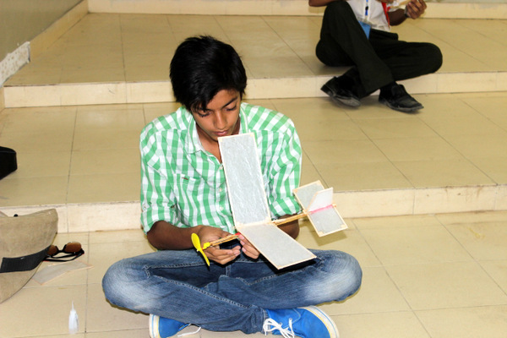
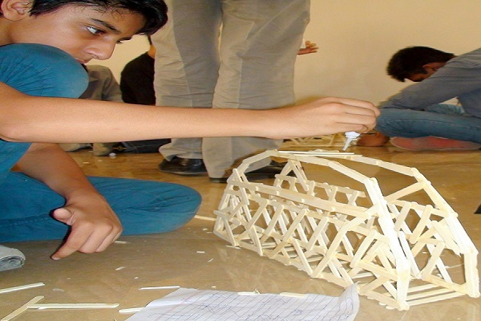
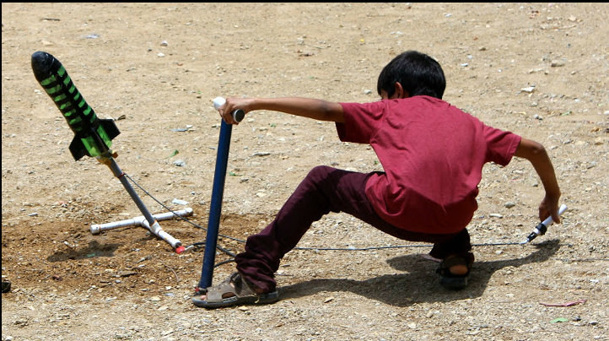

Slide 6
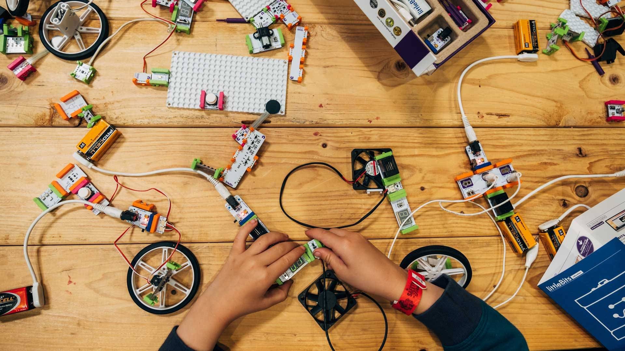
HAVE YOU MADE SOMETHING ?

Slide 7
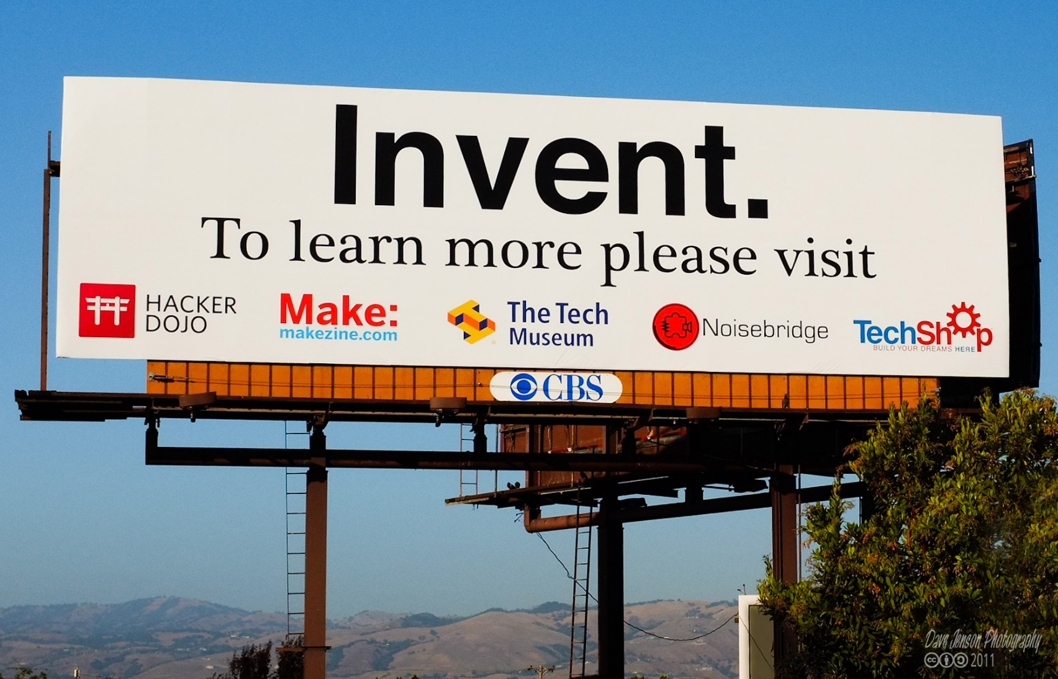

Slide 8
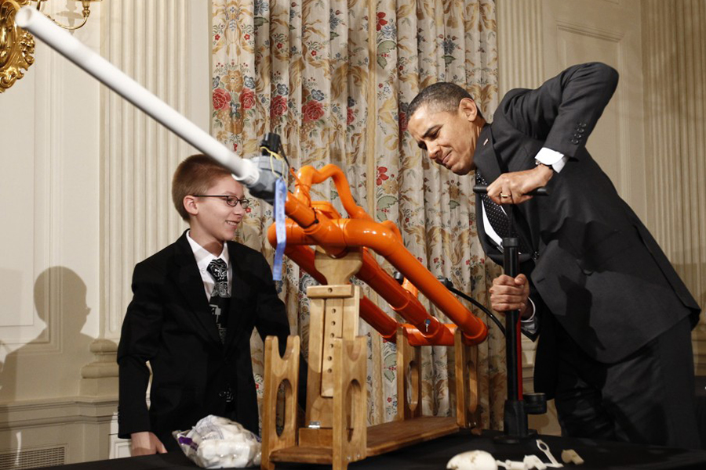
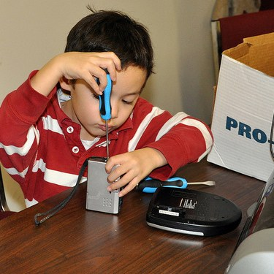

Slide 9
What is MAKING ?
the act of creating something.

Slide 10
What is MAKING ?
the act of creating something.
But it is NOT just the act of creating something
LEARNING
TRYING, FAILING, TRYING AGAIN
and SUCCEEDING

Slide 11
What is MAKING ?

Slide 12
MAKING is important

Slide 13
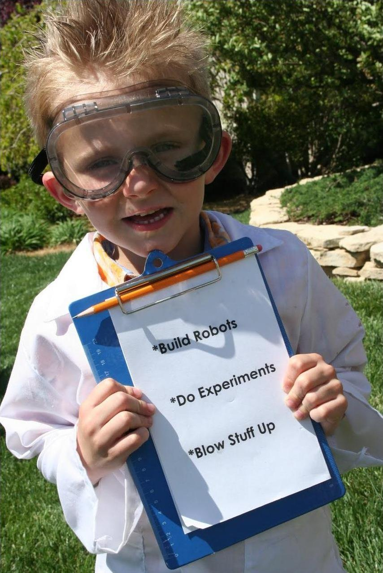
My Story
Got my first soldering iron and a set of electronic components when I was 10.

Slide 14
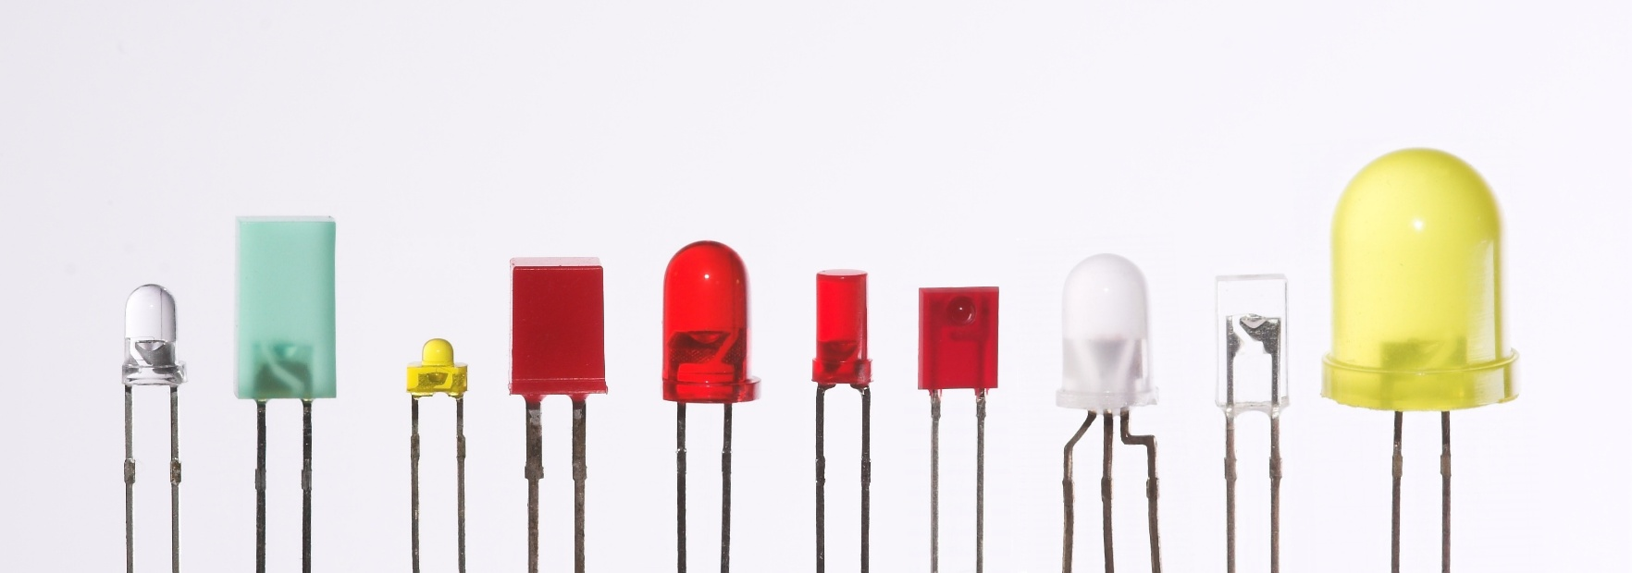
LETS MAKE SOMETHING

Slide 15
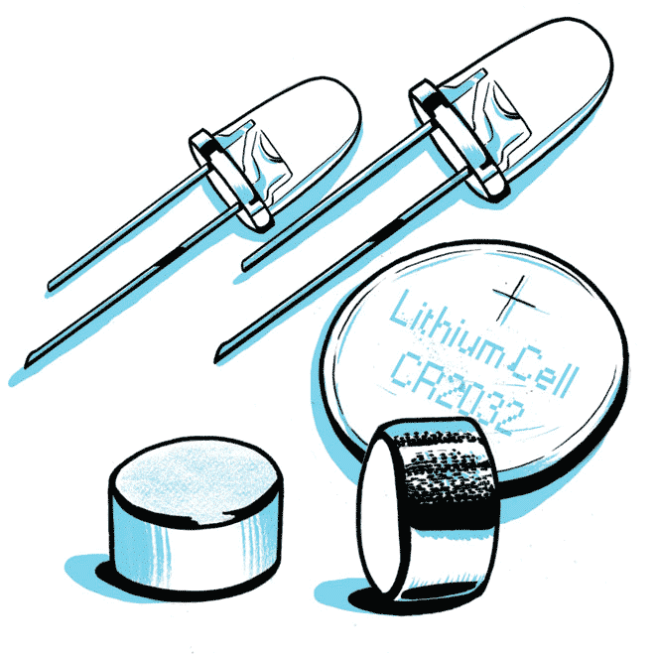

Slide 16
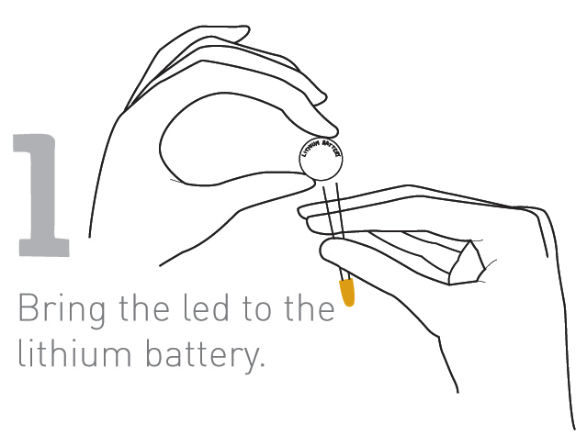

Slide 17
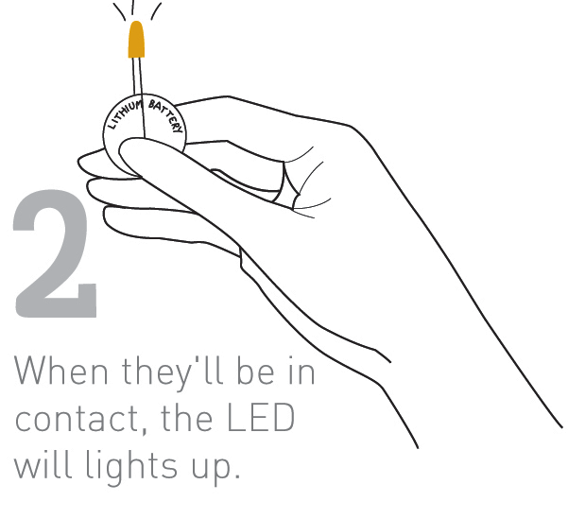

Slide 19
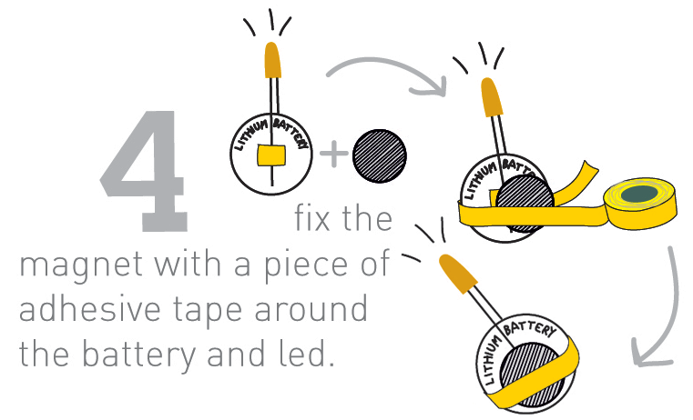

Slide 20
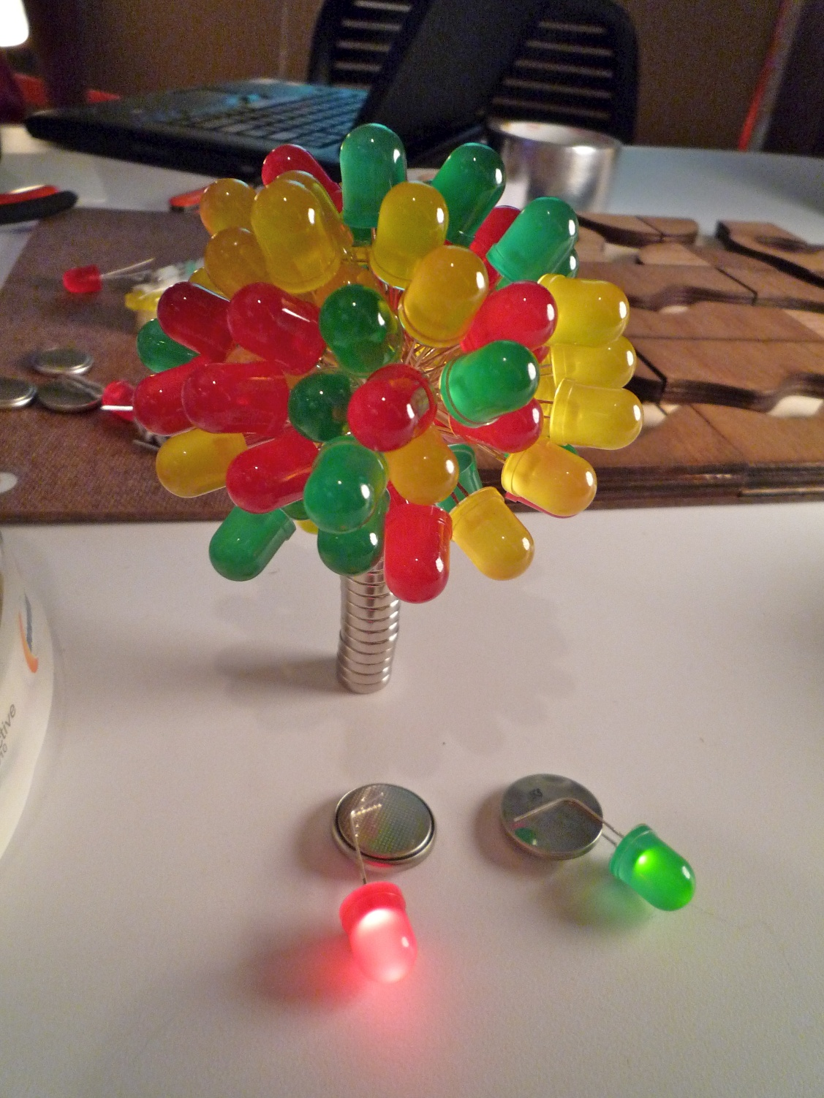
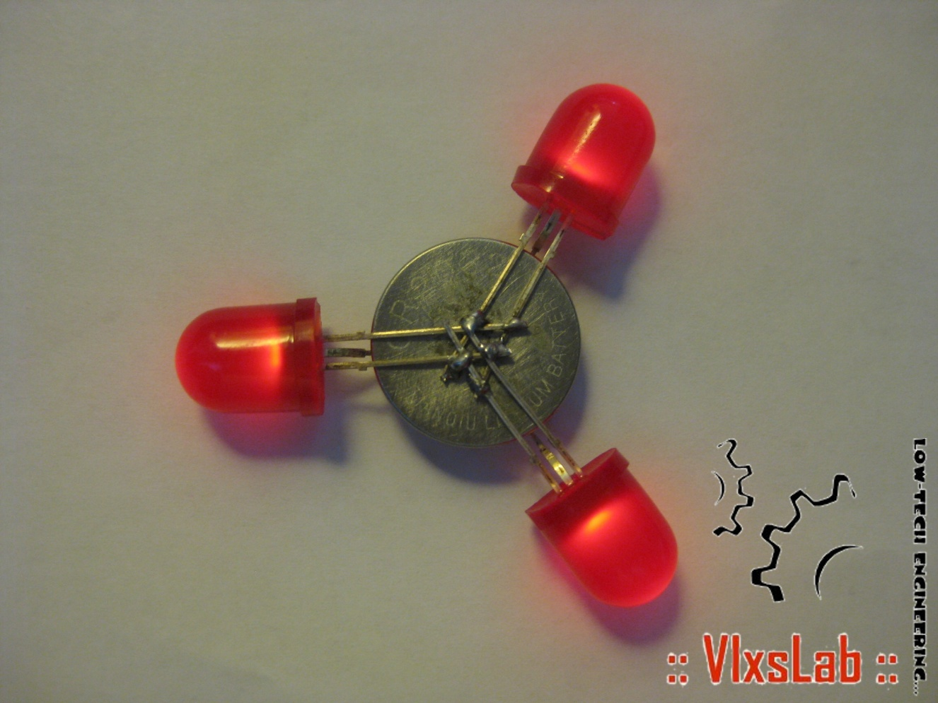
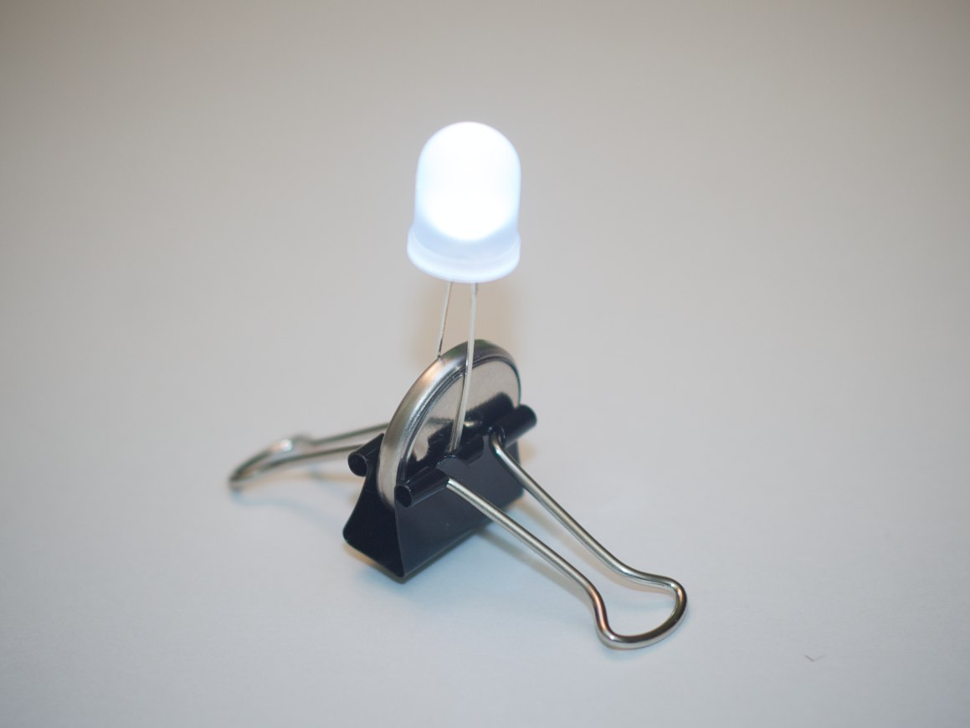

Slide 21
LETS LEARN SOMETHING

Slide 22
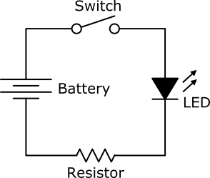
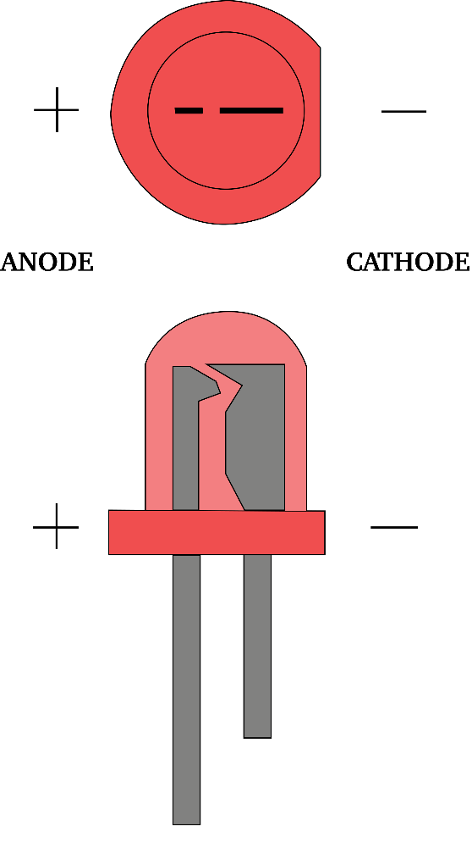
LED – LIGHT EMITTING DIODE

Slide 23
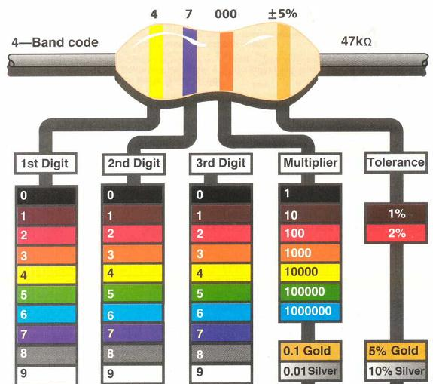
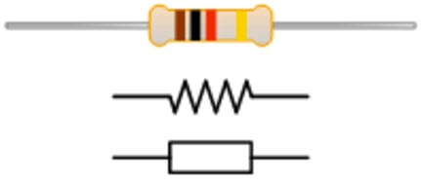
RESISTOR

Slide 24
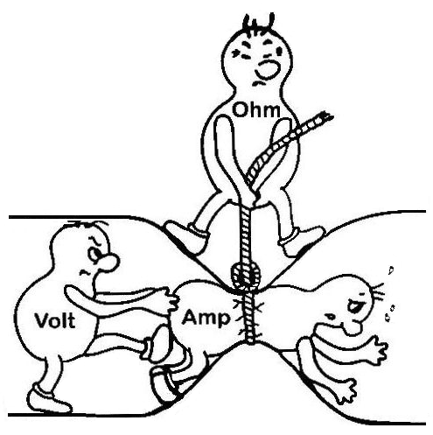
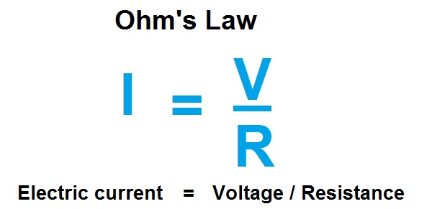
OHMS LAW

Slide 25
LDR – LIGHT Dependent resistor

Slide 26
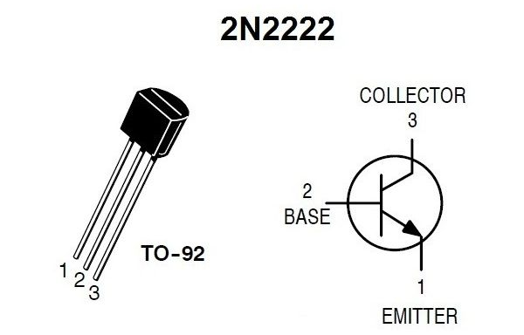
Transistor – npn 2n2222

Slide 27
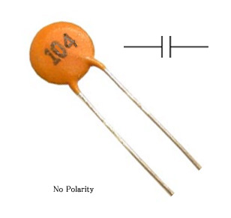
Capacitor – 0.1uF

